Slide 1
Research Project 5.7 Report
Group Member:
Junchao Wang, Yingnan Zhao, Qingfeng Xu

Slide 2
Content
Topic Review
Work Review of Preview Two Weeks
Future Direction
Plan
Current Problem

Slide 3
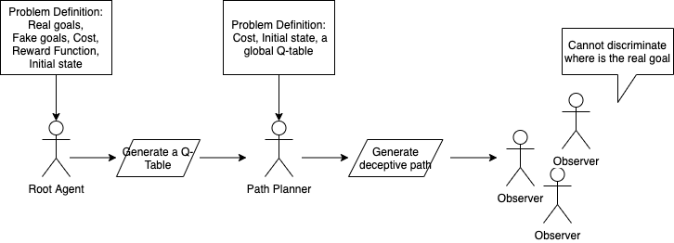
Topic Review
Title: Using single Q funtion to against multiple reward function in deceptive reinforcement learning
Expected Outcomes:

Slide 4

Work Review-Solution: Reward Shaping
we update a Q-function when a reward is received. E.g, for 1-step Q-learning:
The approach to reward shaping is not to modify the reward function, but to just give additional reward for some moves:
The function F provides heuristic domain knowledge to the problem

Slide 5
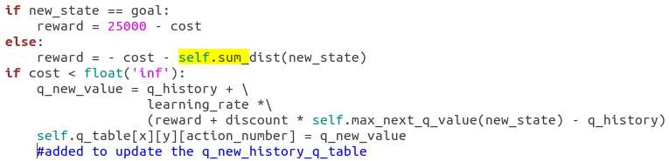
Work Review-Application
We add the sum of distance to all fake goals as additional goal. There are two benifits:
1. The real goal will lead the agent to find the correct path which is aiming to real goal
2. The agent will find a path to approach fake goal because the additional rewards.

Slide 6
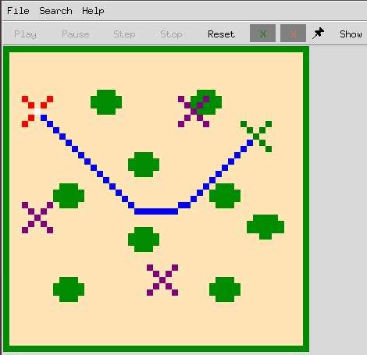
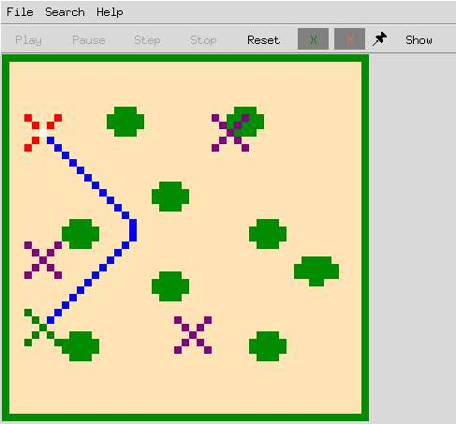
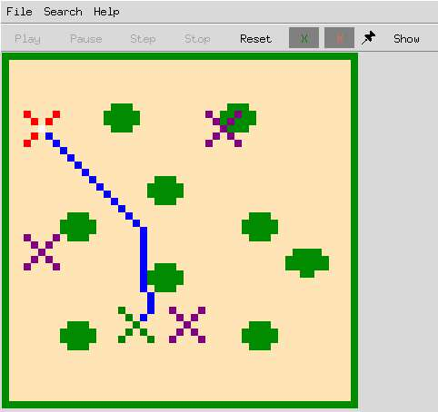
Work Review-Result

Slide 7
Future Direction-Cost Reduce
We are going to reduce the cost of the deceptive path, there are two points
Pruning some fake goals
Optimize the heuristic reward F and the relationship between F and real reward
Problem
We also meet some programming bugs, such as the the agent stops in some cases.
Notes:
这两张图是论文中用来比较的方法。我们直接获取图中需要的数据然后放上对比就可以了

Slide 8

Ideas for pruning
Design a advantage of action a for including fake goals:
Such as
Now the problem comes to deal with R(o), since we don’t want to show the reward function. Currently we plan to generate different Q-table that contains different heuristic reward F
Ari (s, a) < δ, in which δ is a pruning parameter.
If δ = 0, a fake goal is pruned because it offers no advantage from the current state.
If δ < 0, the pruning would be less aggressive, allowing some actions that do not offer an advantage.
If δ = −∞, we would never prune a reward function.

Slide 9
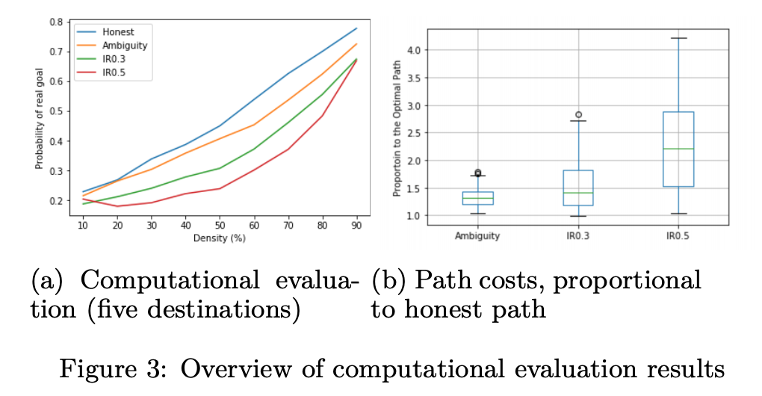
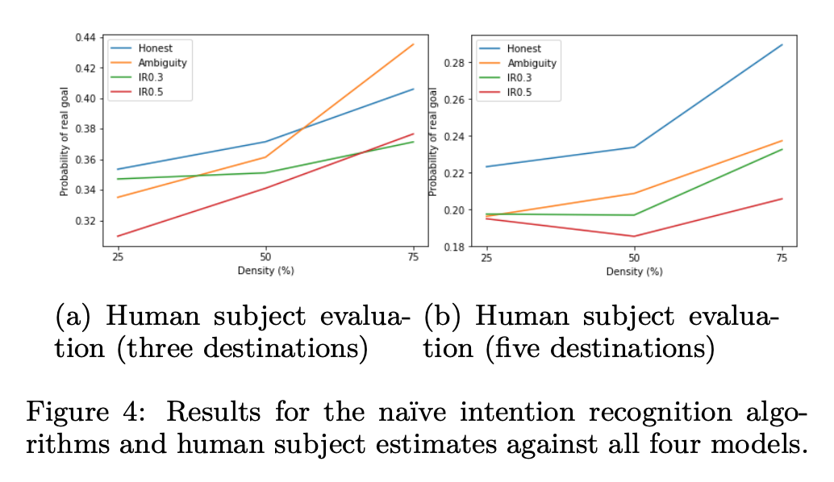
Future Direction-Evaluation
We will evaluate our model by comparing with Irrational Model and Ambiguity Model
Notes:
这两张图是论文中用来比较的方法。我们直接获取图中需要的数据然后放上对比就可以了

Slide 10
Plan
Time | Item | Expect Outcomes
5.7 – 5.10 | Pruning fake goals | Finish Pruning fake goals algorithm
5.10 -5.14 | Optimize heuristic reward | Find heuristic reward that performing well
5.14 -5.16 | Test | Test and fix bugs
5.16 -5.18 | Collect evaluation data | Collect the data that we use to compare with other models
5.18-5.21 | Collect human object evaluation data | Use questionnairs to test result by human

